Slide 1
Introduction to
Red Hat Enterprise Linux
&
Command Line

Slide 2
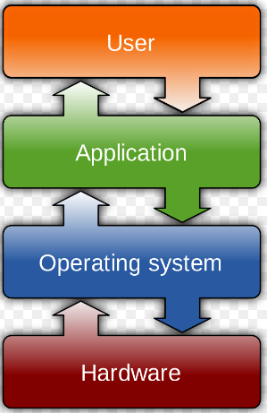
Operating System
An Operating System (OS) is an interface between a computer user and computer hardware
It is a software that directly manages a system’s hardware and resources, like CPU, memory, and storage.
It performs all the basic tasks like file management, memory management, process management, handling input and output, and controlling peripheral devices such as disk drives and printers.
Linux is an open source operating system

Slide 3
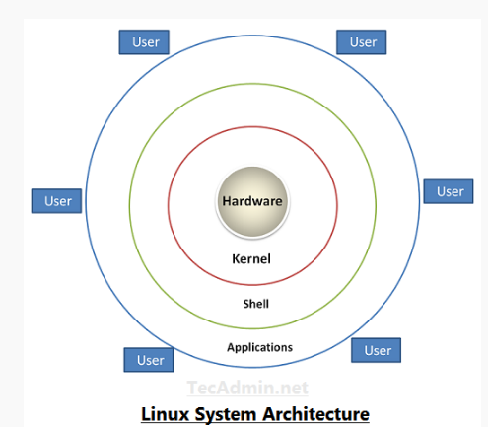
Architecture of a Linux System.

Slide 4
Hardware − Hardware consists of all physical devices attached to the System. For example: Hard disk drive, RAM, Motherboard, CPU etc.
Kernel − Kernel is the core component for any (Linux) operating system which directly interacts with the hardware.
Shell − Shell is the interface which takes input from Users and sends instructions to the Kernel, Also takes the output from Kernel and send the result back to output shell.
Applications − These are the utility programs which runs on Shell. This can be any application like Your web browser, media player, text editor etc.

Slide 5
Linux distributions
Redhat Enterprise Linux
Fedora
Debian
CentOs
Ubuntu
Suse Enterprise Linux
Linux Mint
Puppy linux
KUbuntu
Linux comes in various flavours.
The basic system is same, but the look and feel and other applications can be different as per the distribution
Each version of Linux is produced by different organization, for different set of users

Slide 6
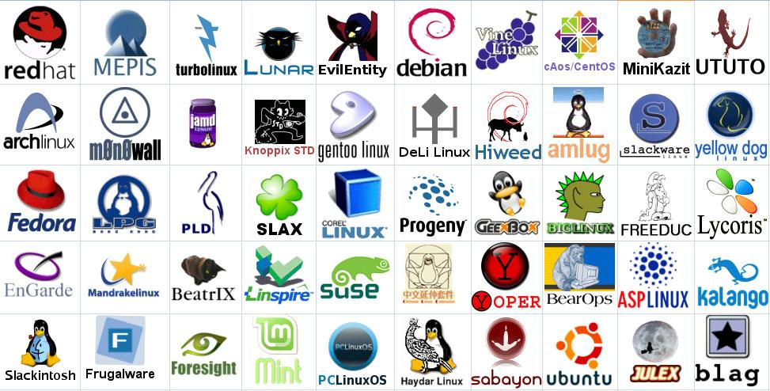
Linux Has Many Distributions
Notes:
Logos source: http://www.muylinux.com/wp-content/uploads/2009/04/logos-distros.jpg

Slide 7




What is Linux?
Linux + GNU Utilities = Free Unix
Linux is an O/S core written by Linus Torvalds and others
a set of small programs written by Richard Stallman and others. They are the GNU utilities.
http://www.gnu.org/
Notes:
Richard Stallman source: http://www.stuffyouwillhate.com/wp-content/uploads/richard-stallman.jpg
Linux Torvalds source: https://netfiles.uiuc.edu/rhasan/linux/Linus_Torvalds.jpg

Slide 8
Introduction to Linux System Administration
Linux is a major strength in computing technology.
Most of the web server, mobile phones, personal computers, supercomputers, and cloud-servers are powered by Linux.
As Linux has high stability, high security, and open-source environment.
The duty of a Linux systems administrator is to manage the operations of a computer system like maintain, enhance, create user account/report, taking backups using Linux tools and command-line interface tools

Slide 9
System Administrator
• The “root” user account is the super user account in linux operating system.
• root user has access to everything i.e all user accounts, their home directories, and the files; all system configurations; and all files on the system.
• A system administrator has access to “root” (Super user) account

Slide 10
Duties of Linux System Administrator
1. Installing and configuring servers
2. Installing and configuring application software
3. Creating and maintaining user accounts
4. Backing up and restoring files
5. Monitoring and tuning performance
6. Configuring a secure system
7.Using Tools to monitor security

Slide 11
Shell
Shell is an interface between operating system kernel and end user.
It is the command interpreter that executes other programs.
It provides a computer user an interface so that the user can run different commands or utilities/tools with some input data. When it finishes executing a program, it sends an output to the user on the screen.
$ is called the command prompt or shell prompt

Slide 12
Different Linux Shells
Sh
• Bourne shell is referred to as "the shell".
• It is used in single user mode for trouble shooting purpose in Linux Operating systems.
• This is default shell for UNIX operating system.
• There is no option to re-edit previous commands.
• Bourne shell is located under /bin/sh.
• Command to open this shell is $sh

Slide 13
Different Linux Shells
Bash
• Bash stands for Bourne Again Shell and it is the default shell in macOS, Windows Subsystem for Linux, and the majority of Linux operating systems.
• The Bash shell is a combination of features from the Bourne Shell and the C Shell.

Slide 14
Different Linux Shells
Korn Shell
• This is based on the Bourne shell.
• One enhancement is its command-line editing facility. It is possible using vi to recall and edit previous commands.
• History mechanism was introduced in this shell.
• korn shell is located under /bin/ksh, if it is installed.
• Command to open this shell is $ksh
• Command to check executed commands $history

Slide 15
Different Linux Shells
C Shell
• The c shell syntax is taken from the C programming language.
• It is a useful tool for anyone familiar with C programming.
• This shell is located under /bin/csh, if it is installed.
• Command to open this shell is $csh

Slide 16
Different Linux Shells
tcsh
• tcsh is like C Shell but it has number of enhancements.
• It is very popular with C programmers for R&D purpose.
• This shell is located under /bin/tcsh, if it is installed.
• Command to open this shell is $tcsh .

Slide 17
Different Linux Shells
zsh
• A shell that is compatible with Bash but offers even more features.
• This shell is located under /bin/zsh, if it is installed.
• Command to open this shell is $zsh

Slide 18
Different Linux Shells
sash
• This stands for stand-alone shell.
• This is a minimal-feature shell that runs in almost all environments. Therefore, it is very well suited for system troubleshooting.
• This shell is located under /bin/sash, if it is installed.
• Command to open this shell is $sash

Slide 19
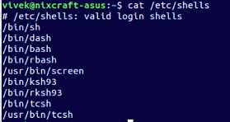

Slide 20
Working with the Bash Shell
Bash stands for Bourne Again Shell and it is the default shell on many Linux distributions.
• The Bash shell is a combination of features from the Bourne Shell and the C Shell.
• It has a command-line editor that allows the use of the cursor keys in a more "user friendly" manner
The default prompt is $
• This shell is located under /bin/bash.
• Command to open this shell is $bash

Slide 21
Useful Bash Key Sequences:
• Ctrl+C :Use this key sequence to quit a command
• Ctrl+D :This key sequence is used to send the end-of-file (EOF) signal to a command. Use this when the command is waiting for more input. It will indicate this by displaying the secondary prompt >.
• Ctrl+R :This is the reverse search feature. It opens the reverse-i-search prompt. This feature helps you locate commands you have used previously.
• Ctrl+Z :Some people use Ctrl+Z to stop a command. It does stop the command, but it does not terminate it.
• Ctrl+A :The Ctrl+A keystroke brings the cursor to the beginning of the current command line.
• Ctrl+B :The Ctrl+B keystroke moves the cursor to the end of the current command line.

Slide 22
Working with Bash History
history -helps you remember the last commands you used. By default, the last 1,000 commands of any user are remembered.
History allows you to use the up and down arrow keys to navigate through the list of commands that you used previously.

Slide 23
You can also repeat commands from history using !
! followed by the number preceding the command you want to be repeated eg :!5
.bash_history (note that the name of this file starts with a dot), ---which stores all of the commands you have used before. Every user has such a file, which is stored in the home directory of the user.
Since the name of the file begins with a dot, it is a hidden file, and normal users cannot see hidden files.

Slide 24
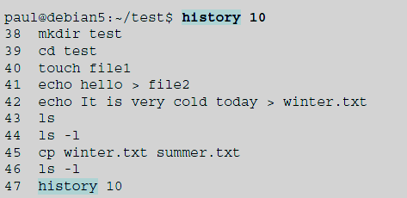

history – c :This will clear the history list for the user who uses this command.

Slide 25
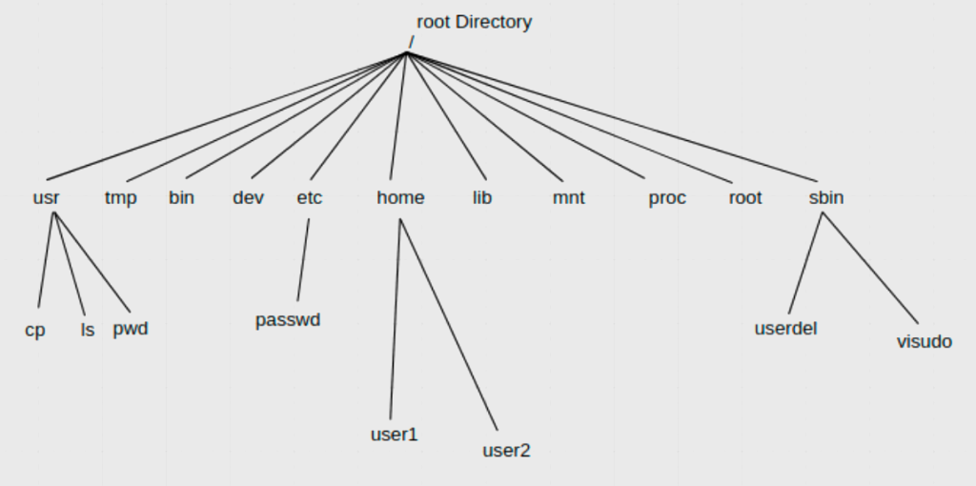
Working with Directories

Slide 26
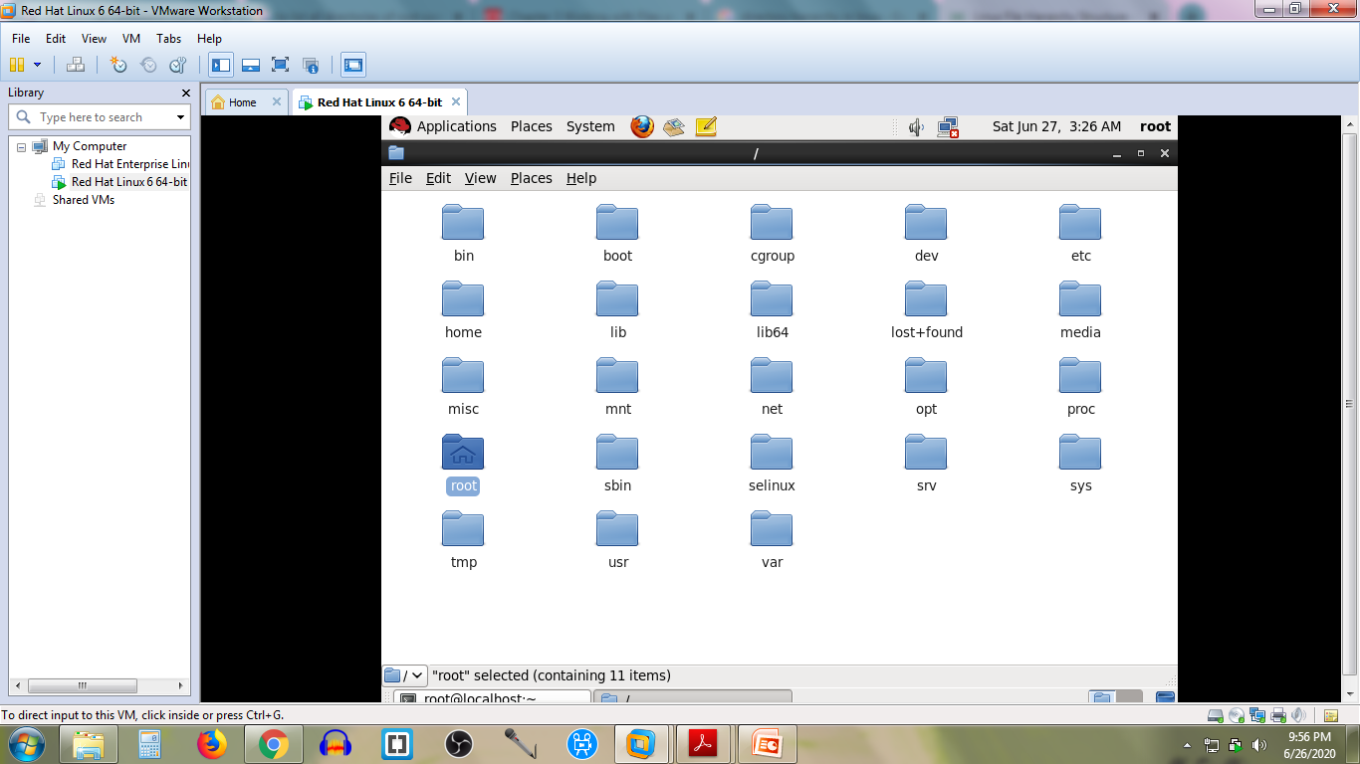
Places ->computer ->file system

Slide 27
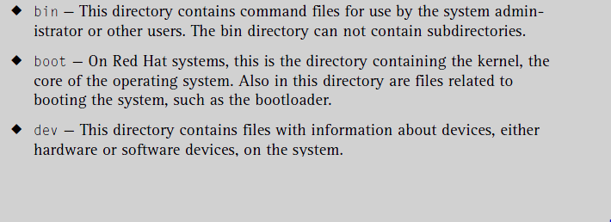
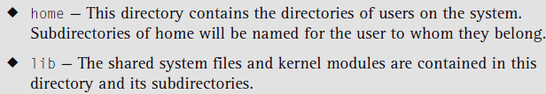

Slide 28
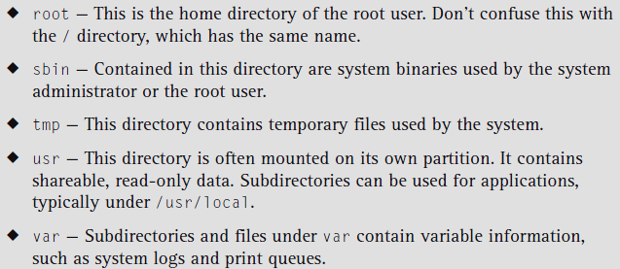
networking related files are in the subdirectory - sysconfig ie : etc/sysconfig

Slide 29

Commands
pwd : The pwd command stands for Print Working Directory. Displays current working directory
cd -Use this command to change the current working directory
Linux uses a forward slash instead of a backslash
names of commands and directories are case-sensitive
eg : cd /bin
Source: www.Edureka .com

Slide 30
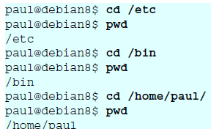
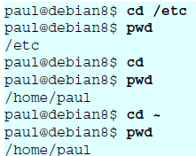

cd ~ : This command also changes the directory to home directory
cd / : Changes the directory to root directory
cd .. : Changes the directory to its parent directory

Slide 31
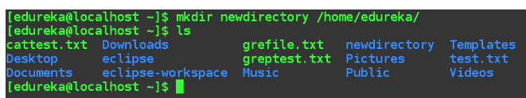
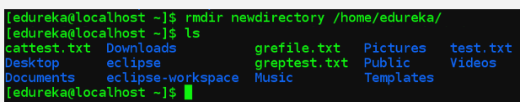
mkdir : To create a new directory
rmdir :to remove directories

Slide 32
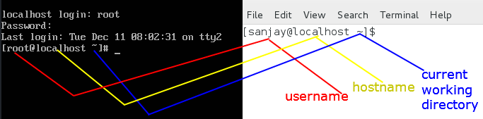
Source :https://www.computernetworkingnotes.com/linux-tutorials

Slide 33
Working with Files
Using ls to List Files
Removing Files with rm
Copying Files with cp
Moving Files with mv

Slide 34
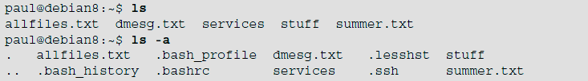
ls command
ls -to list the contents of a directory
ls -a -to show all files. Showing all files means including the hidden files

Slide 35
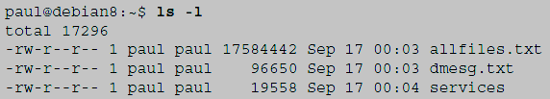
ls –l : to display the contents of the directory in different formats
ls * : will show a list of all files in the current directory
ls [abc]* :will show a list of all files where the name starts with either a, b, or c in the current directory.

Slide 36
rm command
rm :When you use rm to remove a file, the file is gone forever
rm – i : To prevent yourself from accidentally removing a file, it prompts for confirmation for each file that is going to be removed
rm –rf :The rm –rf will erase anything when you are logged in as root. It is used to wipe entire directory structures (the f means force and the r means recursive)

Slide 37
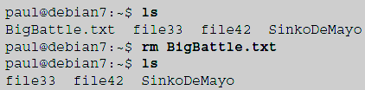
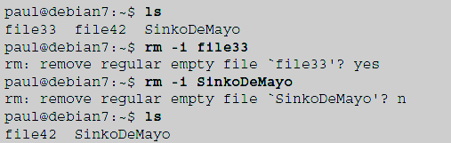
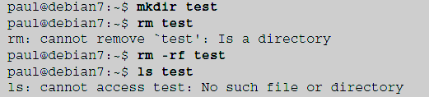

Slide 38
cp command
cp :To copy a file, with a source and a target argument
cp -r :To copy complete directories, use (the -r option forces recursive copying of all files in all subdirectories)
cp –i :To prevent cp from overwriting existing files, use the -i (for interactive) option

Slide 39
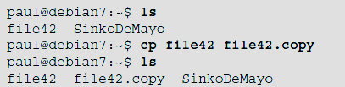

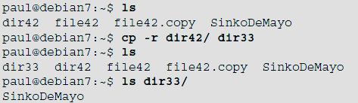


Slide 40
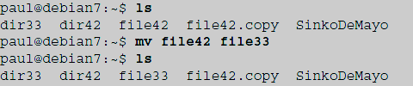
mv command
mv :to rename a file or to move the file to another directory
For eg - to move the filename somefile to /tmp.
mv ~/somefile /tmp/otherfile

Slide 41
THANK YOU

